Slide 1
Hybrid Manufacturing
Innovative production combining additive and subtractive methods

Slide 2

Introduction
Hybrid manufacturing merges additive and subtractive processes to enhance production efficiency and product quality. This approach integrates multiple techniques to overcome limitations of traditional manufacturing, driving innovation across industries.

Slide 3
01
Overview of Hybrid Manufacturing

Slide 4
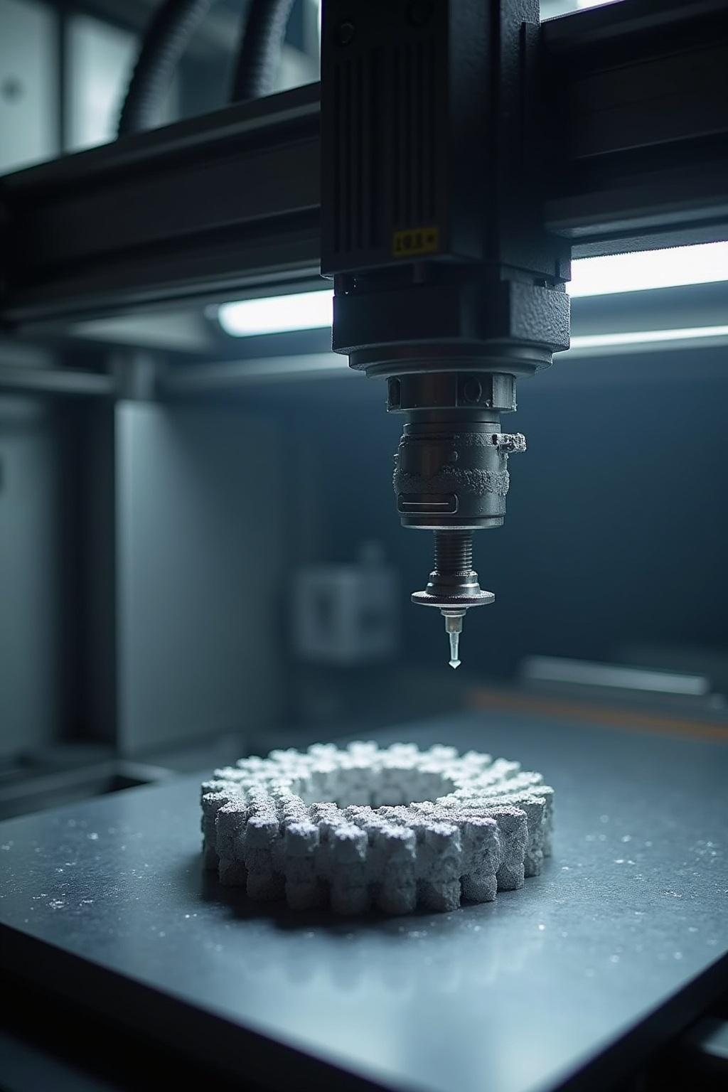
Definition and Concept
Hybrid manufacturing is the integration of additive manufacturing (3D printing) and conventional subtractive processes like milling, allowing for complex and precise part production in a single workflow.

Slide 5
Key Technologies Involved
Core technologies include laser cladding, CNC machining, and metal additive manufacturing. Te hcombination enables improved material properties, reduced lead times, and cost savings.

Slide 6
Advantages over Traditional Methods
Hybrid manufacturing offers improved precision, reduced material waste, and faster production cycles. It combines the flexibility of additive manufacturing with the accuracy of subtractive techniques, resulting in enhanced product performance and cost efficiency.

Slide 7
02
Applications and Challenges

Slide 8
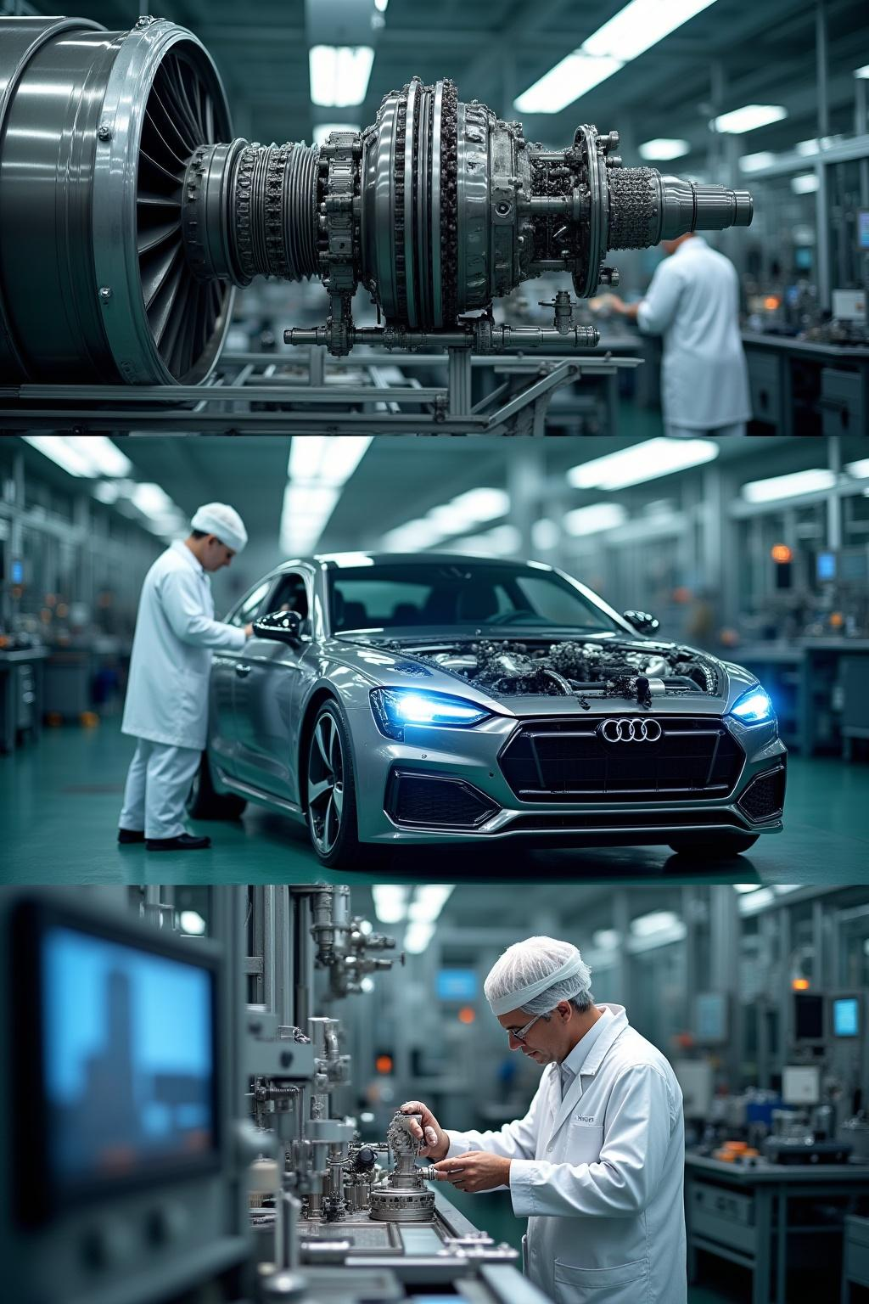
Industry Use Cases
Used extensively in aerospace, automotive, and medical sectors, hybrid manufacturing enables complex part fabrication, repair of high-value components, and customization with high precision and reliability.

Slide 9
Technical and operation chalange
Challenges include integrating diverse technologies, managing process compatibility, and ensuring quality control. High initial costs and skilled workforce requirements also impact widespread adoption.

Slide 10
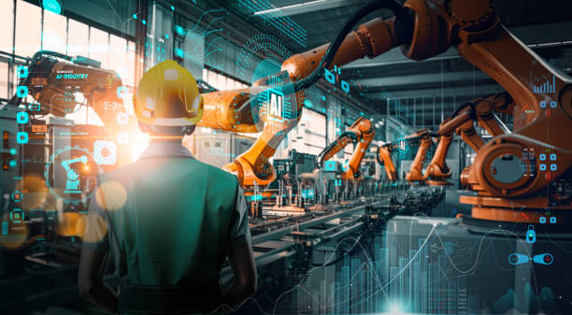
Future Trends and Innovations
Emerging trends involve AI-driven process optimization, multi-material printing, and real-time monitoring to improve efficiency and expand hybrid manufacturing capabilities in various industries.

Slide 11

Conclusions
Hybrid manufacturing revolutionizes production by merging additive and subtractive methods, offering significant benefits in precision, efficiency, and application scope. Overcoming current challenges will unlock its full potential as a key technology for future industry innovation.

Slide 12
THANK YOU….

